Slide 1
CSE425 Presentation
Topic:
Regularization
By:
Shakib Al Hasan
ID: 19201049
Section: 01

Slide 2
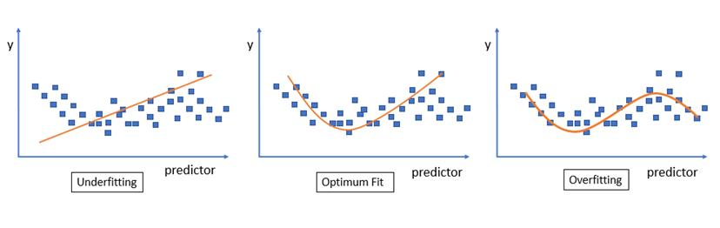
Regularization
Regularization: Reducing overfitting errors to ensure more accurate output recognition.
Overfiitng: Occurs when the learning model captures the noise in the data. It has a low bias but a high variance.
Underfitting: Occurs When the model does not match the data properly. It has a low variance and a strong bias.
Fig: Curve Fitting in Learning Model

Slide 3
Important Regularization Techniques
L1 Regularization
L2 Regularization
Drop Out Regularization
Early Stopping Regularization

Slide 4
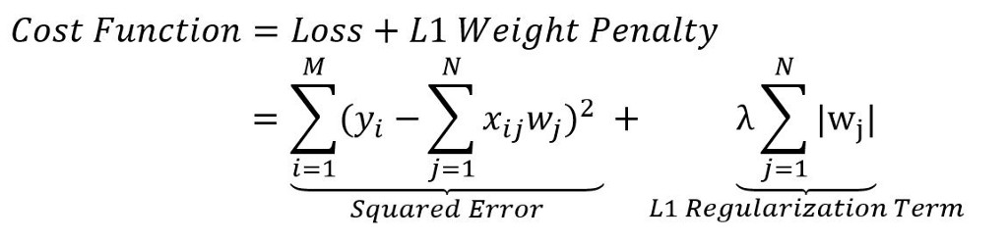
L1 Regularization
A penalty is introduced to suppress the learning model from getting overfitted.
A regularization term is added in the loss function.
Adding the regularized term makes the loss function generalized.
Fig: L1 Regularization

Slide 5
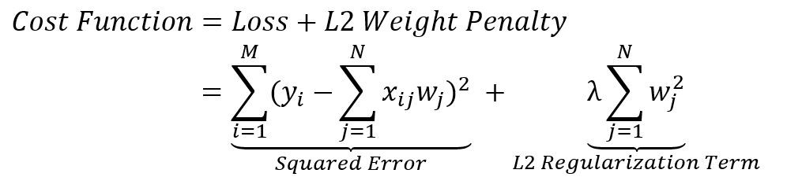
L2 Regularization
Introduces a new cost function by adding a penalty term to a loss function known as L2 weight penalty.
Weight penalty is calculated by taking the squared magnitude of the coefficient, for a summation of squared weights.
The larger the value of the coefficient, the higher is the penalty for complex features of a learning model.
Fig: L2 Regularization

Slide 6
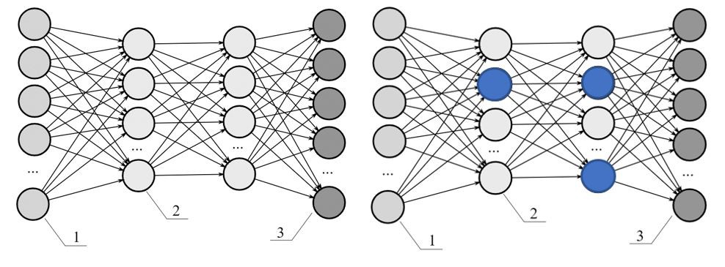
Drop Out Regularization
Nodes are randomly selected and dropped to make a learning model more generalized.
Largely helps in preventing a learning model from getting overfitted on a training dataset and minimizes the regularization error.
Fig: Drop Out Regularization

Slide 7
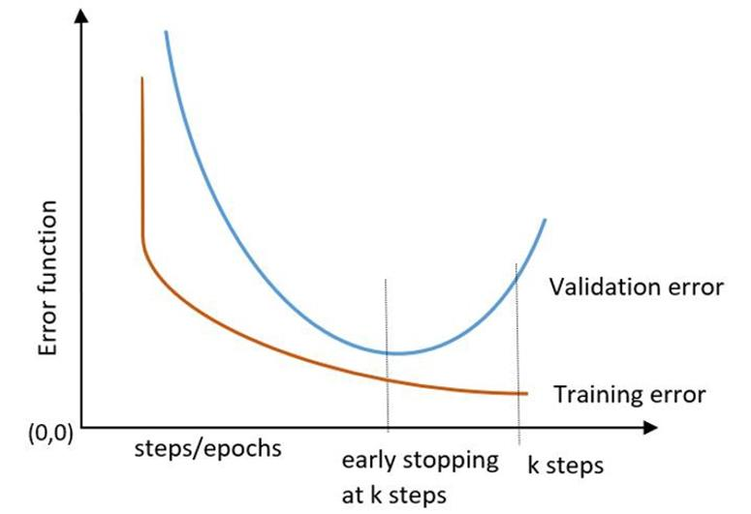
Early Stopping Regularization
Greater number of training iterations improves a learning models performance but increases validation errors leading to overfitting.
Early stopping regularization determines the maximum number of iterations to improve performance without making the model overfitted.
Fig: Early Stopping Regularization

Slide 8
Thank You

